Slide 1

Final presentation Process Mining
Cristian Gavriliu
Technical University of Munich
TUM School of Computation, Information and Technology
Chair 17 - Information Systems and Business Process Management
Munich, 18 January 2023

Slide 2
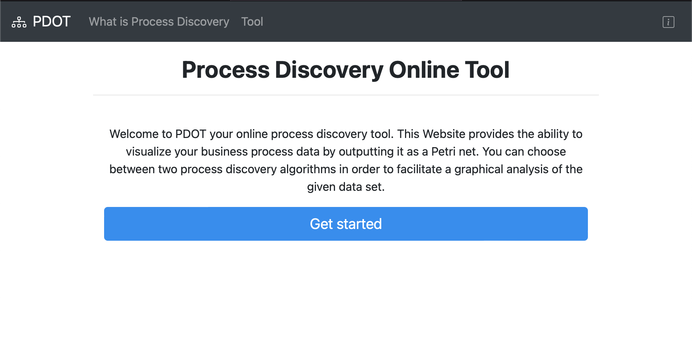
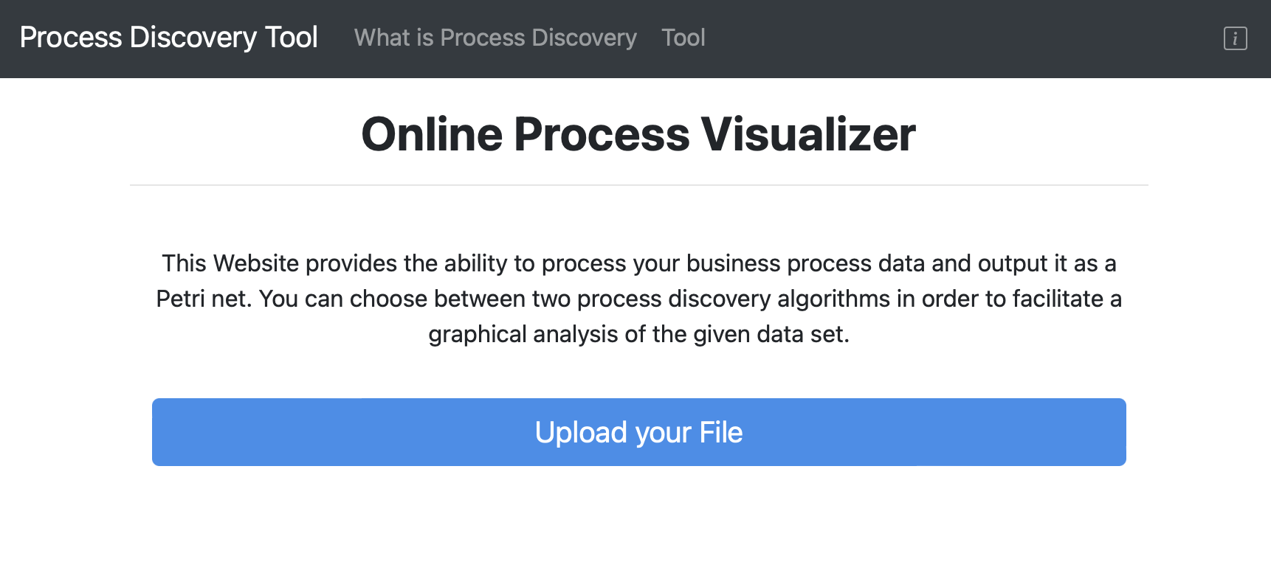

Slide 3
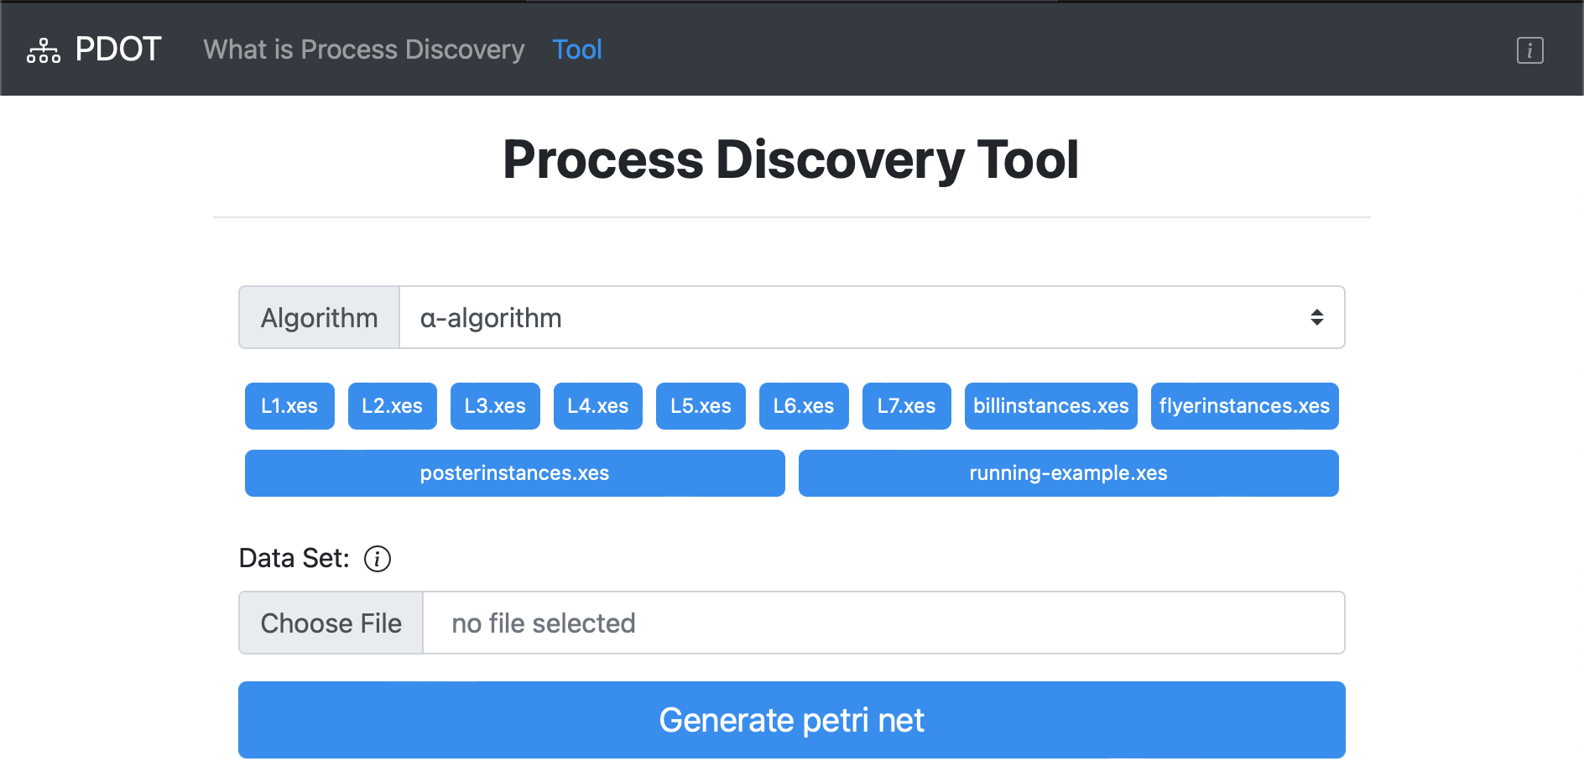

Slide 4
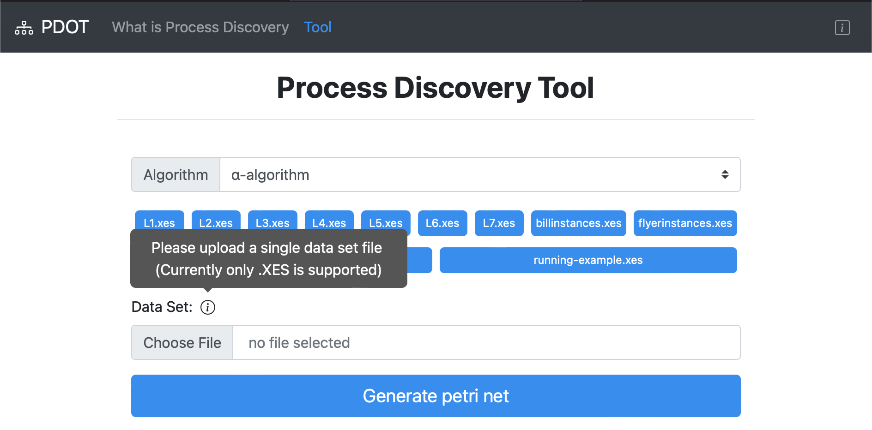

Slide 5
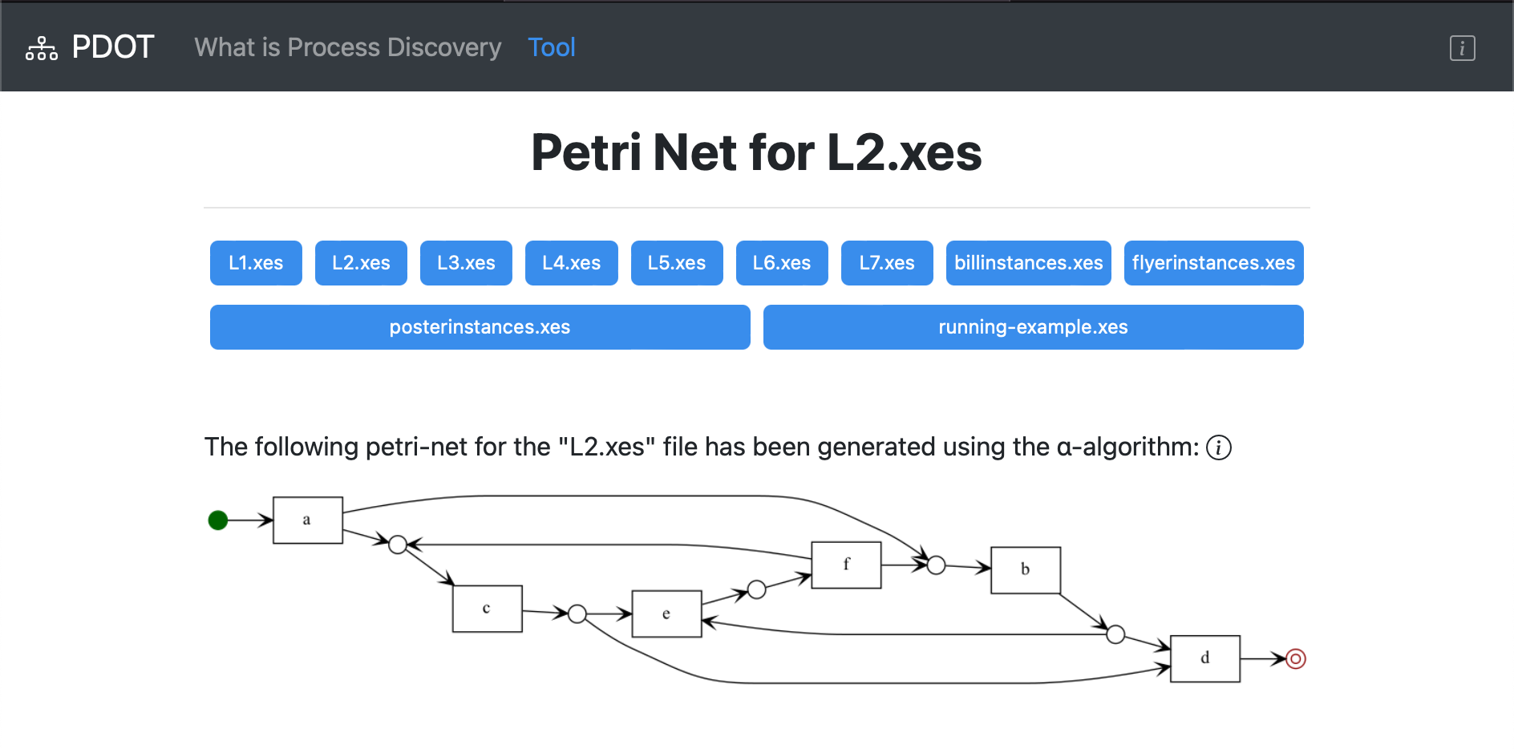

Slide 6
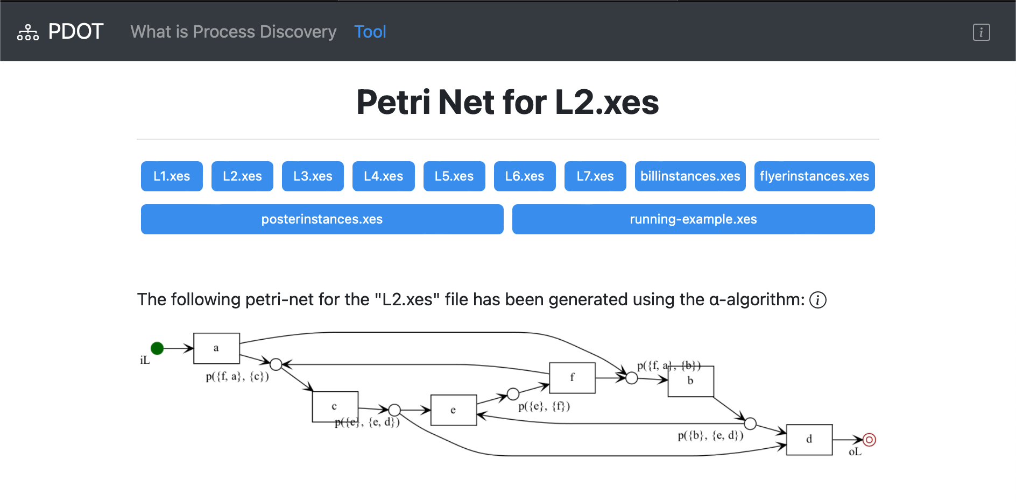

Slide 7
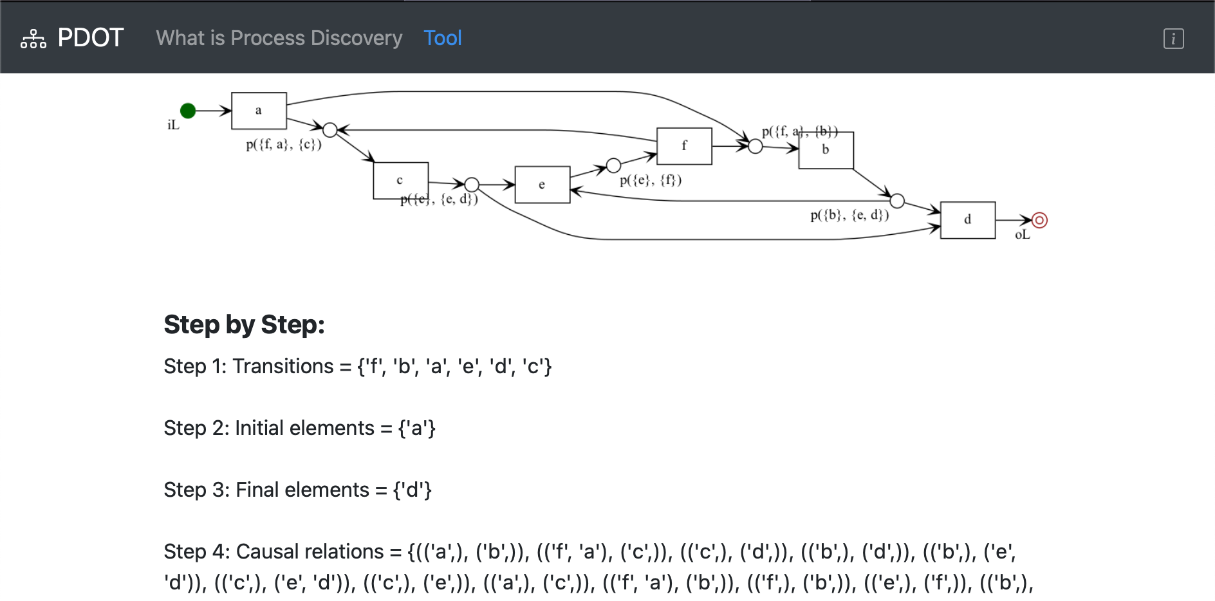
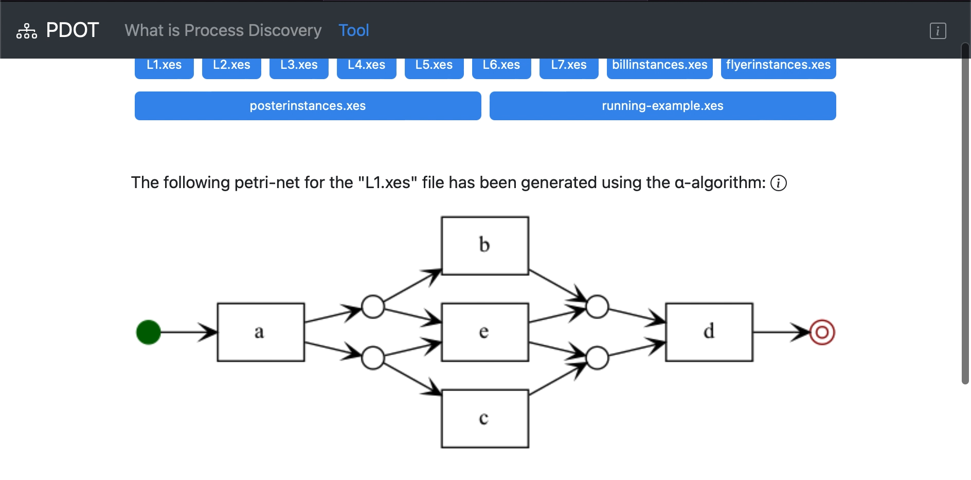

Slide 8
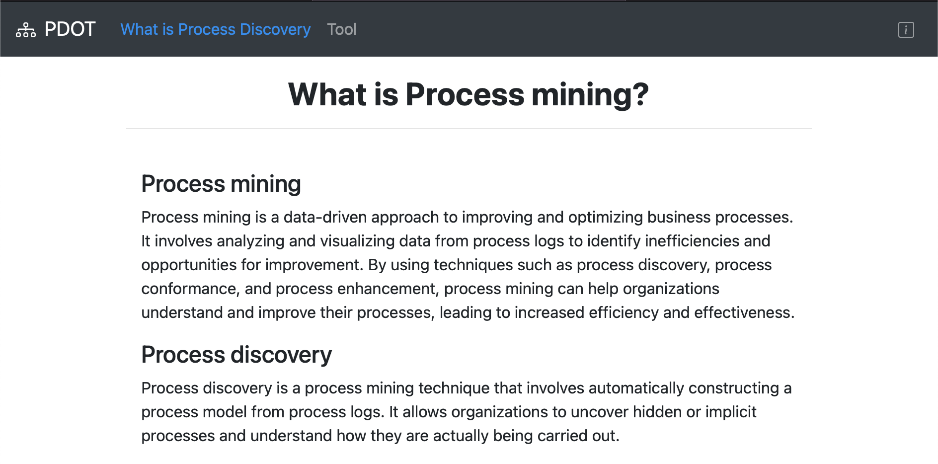

Slide 9
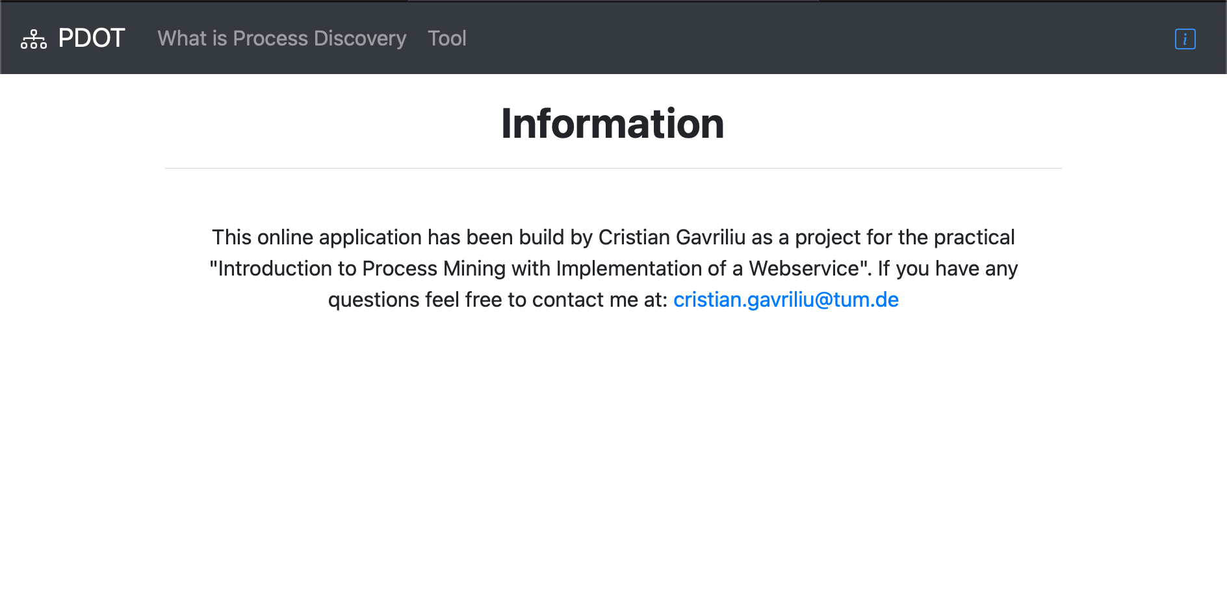

Slide 10


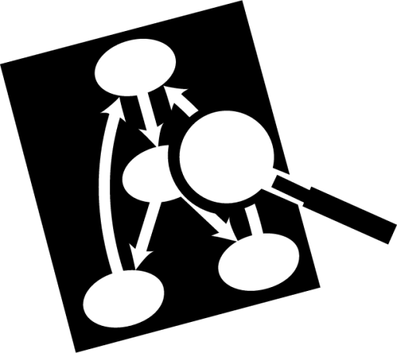




Tech stack
Backend
Frontend
Notes:
IDE: Pycharm
Version Controll: GIT
For ease of installation: Read me and I use venv for the requirments
Backend: Python…. Cgange from snakes to graphviz
Web server: Flask
Front end HTML, CSS, JS bootstrap for styling standar (mobile use)

Slide 11
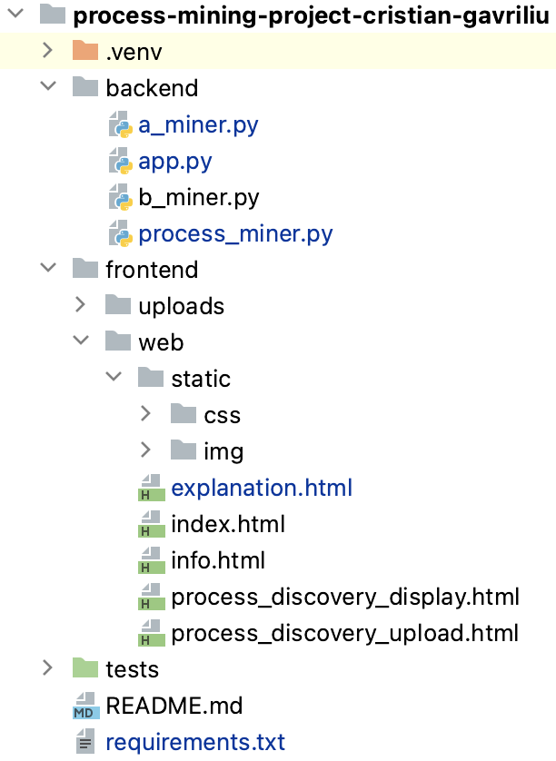
Project Structure

Slide 12
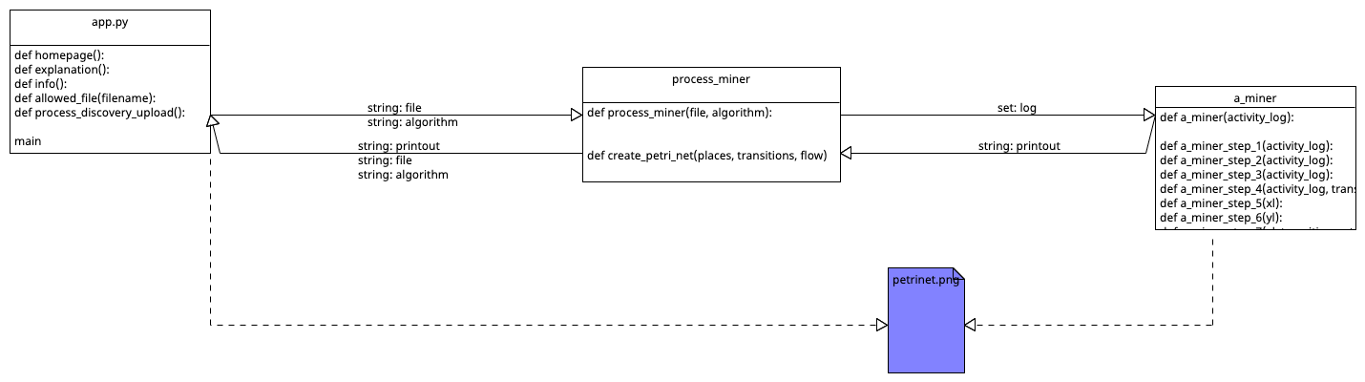
Logic

Slide 13
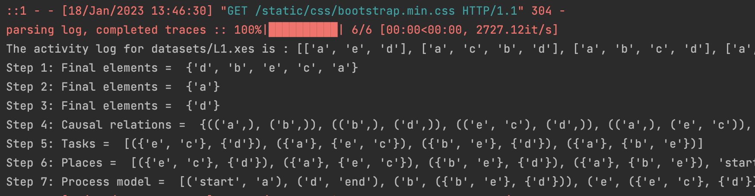
Code
Notes:
Debugging

Slide 14
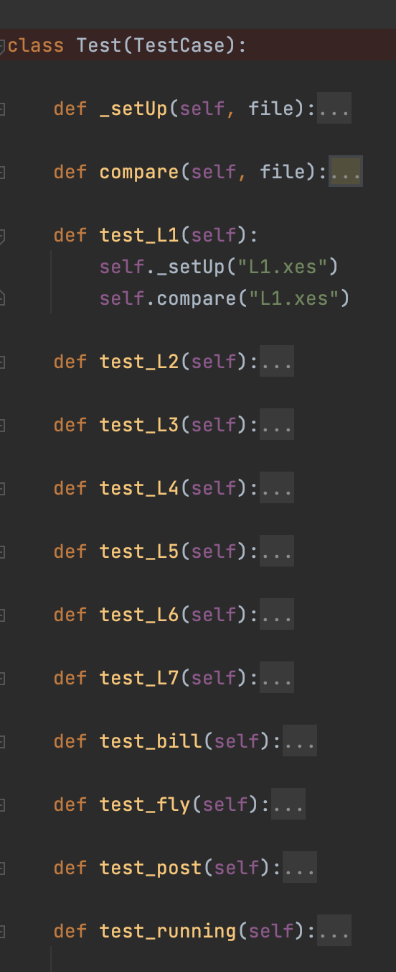
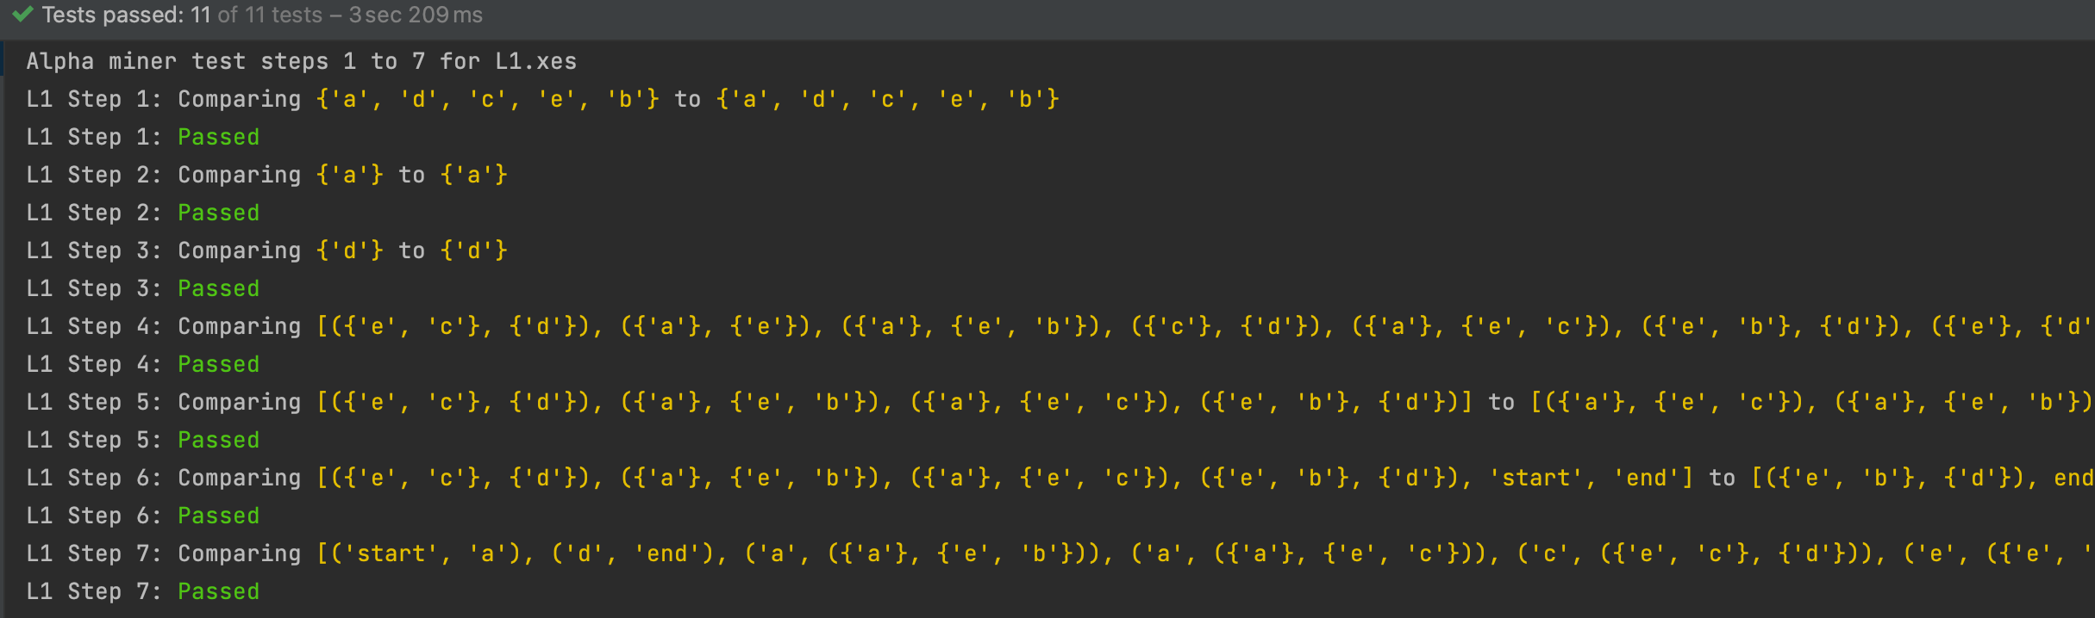
Testing

Slide 15
Timeline and Chalanges
100%
Working Web Front
6 days
20/10 - 27/10
100%
Working Upload
6 days
27/10 - 3/11
100%
Working XES interpreter + α-algorithm (1-3)
6 days
3/11 - 10/11
0%
α-algorithm (4-8)
11 days
10/11 - 24/11
0%
Visualisation + check all unit tests
6 days
24/11 - 1/12
0%
b-algorithm implementation
16 days
1/12 - 22/12
0%
b-algorithm check all unit test
6 days
22/12 - 29/12
0%
Rounding of the project + check everything
6 days
29/12 - 5/1
0%
Upload to server
6 days
5/1 - 12/1
Intermediate Presentation
Final presentation
2022
Oct
Nov
Dec
2023
2023
10/11/2022
Today
12/1/2023
Complete working Front end
!Deadline!
Notes:
First general structure
Basic Flask Application
Expanded to build the complete working front end
Upload
Alpha algorithm which implementation of Unit test while functions
Current status on the project
Still haven't decide on the second algorithm
Struggles so far:
Huge problems with loading specific frameworks, I had some difficulties with the Venv and had to completely re do it
A bit behind scedjuel due to step 4

Slide 16
Thank You
Cristian Gavriliu
Munich, 18. January 2023

